Slide 1
The National Cancer Institute’s Office of Advocacy Relations
Amy Williams
Director, Office of Advocacy Relations
Innovative Molecular Analysis Technologies (IMAT)
Principal Investigators’ Meeting
December 1, 2016

Slide 2
Office of Advocacy Relations (OAR)
NCI's Office of Advocacy Relations (OAR) engages cancer research advocates and serves as a link for advocate stakeholders to collaborate with NCI. OAR works with individual research advocates, local and national advocacy groups, and professional societies to ensure the collective patient perspective is included in NCI efforts to advance cancer research and improve patient outcomes.
Notes:
NCI is dedicated to engaging the cancer advocacy community and continues to develop ways to involve research advocates in its activities.
The mission of the NCI Office of Advocacy Relations (OAR) is to foster meaningful relationships between the Institute and the cancer advocacy community to improve outcomes for patients.
Collaborating with individual research advocates and NCI program staff to ensure the collective patient perspective is consistently and effectively integrated into NCI research activities.
Working with advocacy organizations and other stakeholders to improve understanding of policy, partnership opportunities, and strategic investments in cancer research.

Slide 3
What We Do
As part of NCI’s Office of the Director, OAR coordinates meaningful engagement across the cancer research advocacy community to improve understanding, opportunity, and progress in cancer research.
Communicate
Facilitate
Collaborate
Notes:
Simply put, the Office of Advocacy Relations works with the advocacy community to advance cancer research.
To achieve our mission, we perform three broad functions on a regular and bi-directional basis: communication, facilitation, and collaboration.
We communicate NCI’s priorities and initiatives throughout the community and we use different vehicles to do this, including social media or webinars, and we’re always looking to expand our promotion efforts. We also relay information and feedback from the community to leadership at NCI to shape new projects or decision-making, as well highlight concerns.
We also facilitate bi-directional engagements, meaning we regularly match individual advocates to activities within NCI, such as different working groups or steering committees, and we often coordinate NCI-expert speakers to participate in advocate events, briefings, and conferences.
Lastly, we work collaborate with the community to illuminate new opportunities and partnerships that leverage diverse resources or meet overlapping priorities, both with NCI and amongst various external stakeholders.

Slide 4
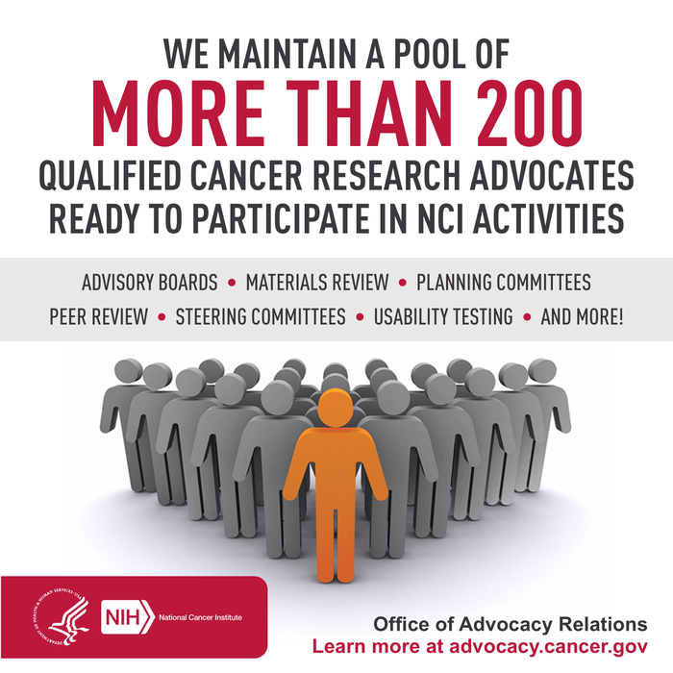
Engaging Research Advocates
Serve the Institute in connecting the right advocate to the right activity so he or she can provide the most effective and meaningful contributions when working with NCI
Connect qualified advocates to NCI activities based on need, expertise, and interest
Notes:
NCI is dedicated to engaging the cancer advocacy community and continues to develop ways to involve research advocates in its activities.
The mission of the NCI Office of Advocacy Relations (OAR) is to foster meaningful relationships between the Institute and the cancer advocacy community to improve outcomes for patients.
Collaborating with individual research advocates and NCI program staff to ensure the collective patient perspective is consistently and effectively integrated into NCI research activities.
Working with advocacy organizations and other stakeholders to improve understanding of policy, partnership opportunities, and strategic investments in cancer research.

Slide 5
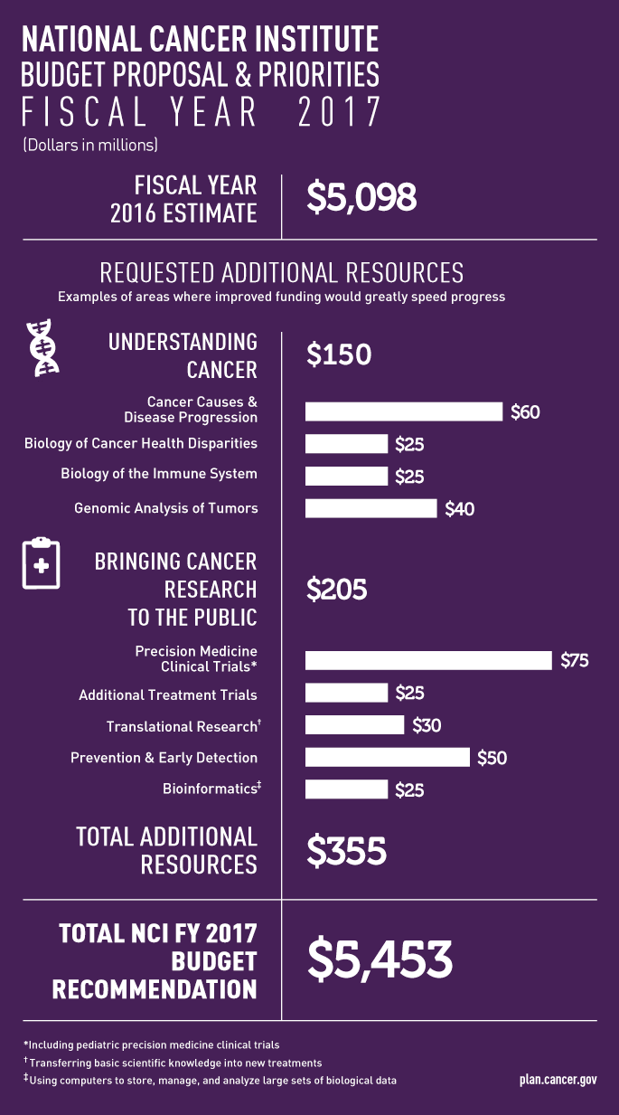
Organizational Engagement
OAR works with organizations, foundations, coalitions, and other groups across the community to advance understanding of policy, partnerships, and strategic investments in cancer research.
Design
Disseminate
Notes:
OAR has always worked with individual advocates as well as advocacy organizations. We work with large advocacy groups to improve the understanding of policy, partnerships, and strategic investments in cancer research. Generally, the group we tend to work with fund their own research or research collaborations, and have a clear public policy agenda.
We will often convene organizations and NCI leadership around key issues and topics to advance cancer research. Sometimes these issues are cancer-type specific, such as a convening on pediatric cancer, or they may be broad, such as clinical trial recruitment or infrastructure. We also connect organizations to leading experts in their areas of interest at the institute.
One of the ongoing strategic engagements OAR coordinates with large groups is the annual promotion of NCI’s bypass budget, which groups often use to craft their own advocacy agendas and messaging.
We’re exploring many new engagement opportunities, including co-funding opportunities with large research foundations, to bring our diverse and complementary resources to bear to advance cancer research.

Slide 6
Types of Advocacy
Fundraising | Raise funds and fund research
Support | Help patients and caregivers navigate complex medical systems
Outreach and Education | Increase public awareness of cancer: risk, prevention, intervention, survivorship
Policy | Partner with policymakers and implementers in order to benefit patients
Research | Bring a unique viewpoint to the research process and communicate a collective patient perspective

Slide 7
Advocate Engagement
Develop recommendations or advise on strategic directions or broad policy issues
Develop new or enhance existing programs or activities
Advise
Design
Advise
Design
Evaluate and analyze research proposals and ongoing research activities
Evaluate and analyze research proposals and ongoing research activities
Interpret and communicate scientific information for nonscientific audiences
Review
Disseminate
Review
Disseminate
Notes:
NCI’s advocate engagement is in service to making progress in cancer research through integrating the collective patient perspective in NCI activities, which means we work with advocates to provide not just their individual experience, but a broader understanding of cancer experiences throughout the community.
We maintain a large pool of nearly 200 individual cancer research advocates who lend their expertise and support to various NCI activities.
This type of engagement may take many forms, but typically falls into one of four categories. Advocates may:
Advise NCI leadership and staff on strategic and policy matters through the participation on a formal advisory board, like the NCI’s Council of Research Advocates (NCRA), the only federal advisory committee comprised of cancer research advocates. (We’ll talk more about NCRA later.)
Draw on their expertise to aid in the design of new programs or assist existing programs with identifying barriers to implementation. A great example of this is the I-SPY trial, a landmark breast cancer trail that benefited from the unprecedented involvement of dozens of breast cancer advocates who helped ensure the trial’s design was as convenient for patients as possible.
Advocates may also be called upon to review scientific proposals, concepts, materials, or other NCI-led initiatives, often as part of a steering committee. Recently, a group of advocates provided review and feedback to the way NCI’s Center for Strategic Scientific Initiatives promoted their grant announcements.
Lastly, advocates play an enormous role in disseminating information to their colleagues and constituents, including promoting new research findings and NCI initiatives.
A few more examples of advocate engagement activities include:
Speaking Engagements
Institutional Review Boards
Research Committees
Task Forces
Protocol Review
Peer Review
Editorial Boards
Webinars
Workshops
Twitter chats
Advisory Boards
Steering Committees
Scientific Meetings
Materials Review
User testing

Slide 8
IMAT: Potential Opportunities for
Advocate Involvement
Provide collective patient perspective and input throughout development pipeline
Create urgency around scientific need
Translate science to educate patient community
Facilitate patient-targeted innovation within research community

Slide 9
Interested in learning more?
advocacy.cancer.gov
NCIadvocacy@nih.gov
(301) 594-3194
@NCIadvocacy

